Slide 1

Strengthening District Health System and HIV Service Delivery Outcomes in Mozambique:
Findings from the CHASS-SMT Project
1 Dec 2015

Slide 2
Background
Growing consensus on the importance of strong health systems for achieving an AIDS-free generation
Need for evidence of impact of HSS interventions
High national HIV prevalence (11.5%)
Low ART coverage rates:
  Scarcity and misallocation of resources
  Low managerial capacity at district/facility level
  Suboptimal support systems and key processes
MOH Acceleration Plan targeting districts with highest unmet need – “High Priority Districts”

Slide 3
Driving Question
What is the relationship between health system strengthening interventions and HIV service delivery outcomes?
Hypothesis: stronger district health systems in the form of improved management capacity will lead to better health services performance
Notes:
This study aims to produce much-needed evidence on the effects of management capacity-building interventions. Empirical evidence on the relationship between strengthened health systems through improved management capacity and improved service delivery outcomes will help guide policy makers on the best investments to maximize their objectives.

Slide 4
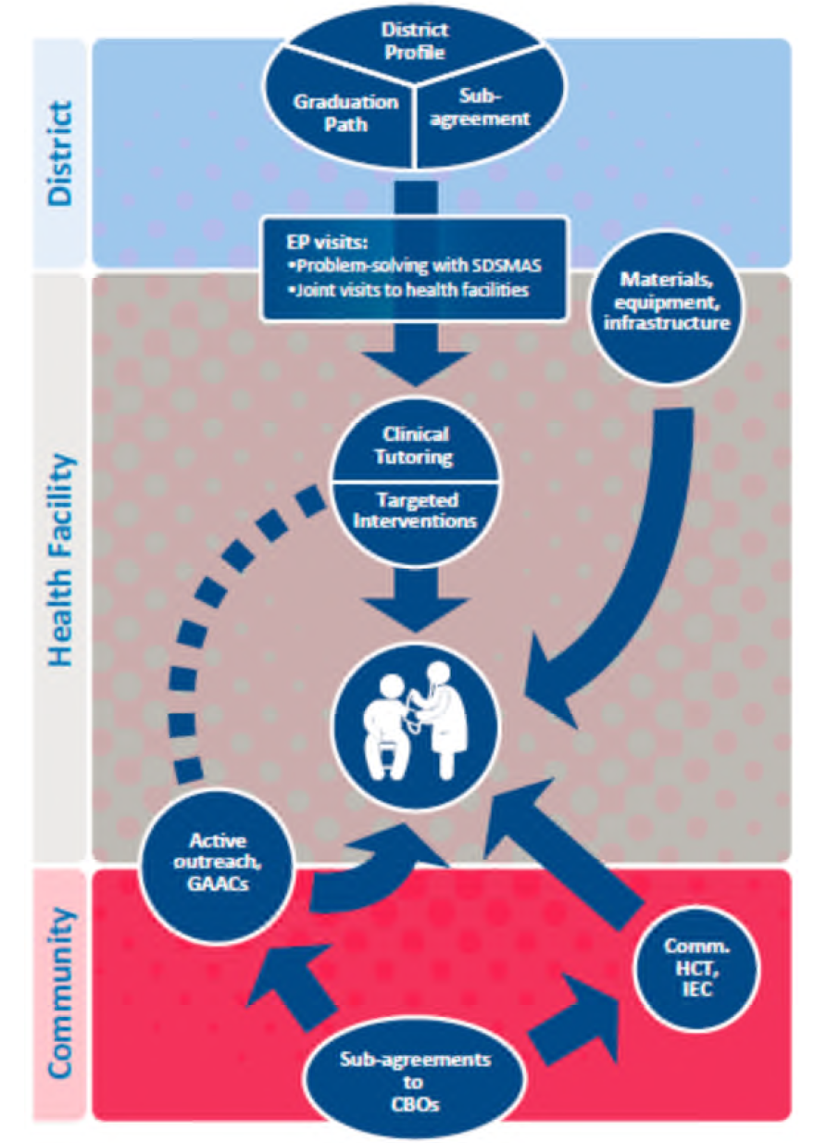
CHASS Intervention Description
District Approach designed to build district capacity to manage and deliver quality services in an environment of growing demand for HIV-care services
Three levels of intervention:
  District
  Health Facility
  Community
Notes:
CHASS-SMT designed the District Approach to address these causes and build the capacity of SDSMAS to manage and deliver quality services in an environment of rapidly growing demand. The District Approach targeted key health system functions starting at the district level and flowing down to the facility and community levels, with improved service delivery as the end goal (Figure 1). The approach can be broadly described in three intervention levels:
• District: Building the capacity of SDSMAS to manage district health systems and services essential to supporting health facilities in delivering quality health services
• Health facility: Improving the capacity of health facilities to provide quality health services
• Community: Strengthening the links between the community and health facilities to improve demand for and access to services
Each level has a series of interrelated components, which help integrate the system strengthening and service delivery components of the District Approach. CHASS-SMT’s polyvalent teams (Equipas Polivalentes or EPs) carried out district visits to implement the interventions. The project worked in all 36 districts in Sofala, Manica, Tete. After the MOH Acceleration Plan identified twelve HPDs in the three provinces, CHASS-SMT provided more intensive technical support to these districts in the form of the full District
Approach to support the achievement of the Acceleration Plan’s goals. The remaining 24 districts – nonpriority districts (NPDs) – continued to receive project support, but received fewer interventions and/or at lower intensity.

Slide 5
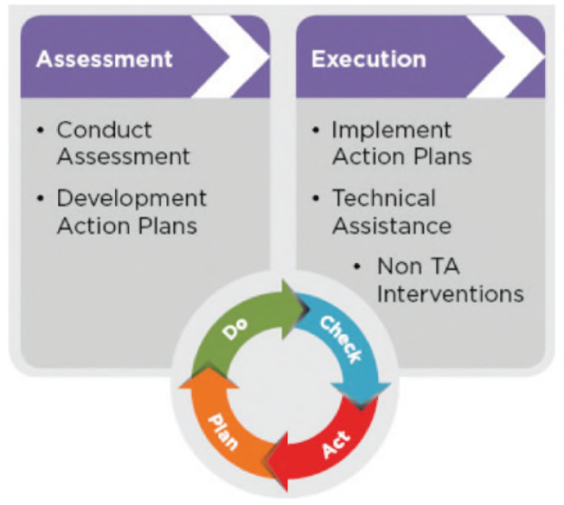
Graduation Path
Designed to strengthen district management capacity
Includes periodic assessments that yield quantitative measures of district management capacity (e.g. “% compliance against MOH standards”)
Notes:
Graduation Path: At the core of the Graduation Path is an assessment tool to measure district management capacity that is based on MOH program management standards. Districts used this tool to conduct a baseline assessment, and repeated the assessment every four to six months to measure progress. This methodology offered a way to structure technical assistance and quantitatively measure progress on HSS interventions, while also linking the interventions to the ultimate goal of improving service delivery. The self-assessment tool – called the District Health Management Standards Tool – measures district performance under eight priority components or functions that form the backbone for sustainable HIV and AIDS health service delivery:
• Systemic functions:
Planning
2. Information systems
3. Human resources
4. Financing
5. Supply and logistics
• Services functions:
6. Health programs
7. Laboratory
8. Community mobilization
Each function contains standards, and each standard contains sub-criteria – overall the tool contains a total of 23 standards and 115 sub-criteria. The sub-criteria are measurable
indicators which ultimately produce a numerical assessment score in the form of “percent compliance with MOH norms,” which is used to measure progress toward “graduation.”
CHASS-SMT systematically supported the districts to conduct this assessment and develop action plans to address the weaknesses identified, as illustrated by the PSDA cycle. Districts then used other elements of the District Approach to support the implementation of their action plans.
District Sub-Agreements: CHASS-SMT provided direct funding through fixed-cost sub-agreements to districts to sustain crucial program implementation activities, facilitate improved operation of the HIV and AIDS program, and empower districts to lead and execute key activities. Sub-agreement-funded activities included: transportation of medications and laboratory sample/results; transport and per diem for district staff to conduct facility supervision; mobile brigades to provide clinical services at the community level; data analysis meetings; and in-service training. CHASS-SMT teams mentored district staff on the budgeting, execution and justification of the sub-agreement funds, supporting their capacity to receive direct funding.
District Profile Analysis: This is a quarterly snapshot of a compendium of district and health facility level indicators, such as district management capacities (Graduation Path), logistics systems for medications and laboratory networks, population coverage rates for key health services, and clinical indicators related to HIV and AIDS services. CHASS-SMT worked with the SDSMAS to systematically analyze these indicators and use the data to determine where to focus efforts and assistance.

Slide 6
Graduation Path
  Each assessment provides a snap shot of the district health system’s compliance against MoH standards
  Standards broken down in 8 characteristics across 2 categories:
      1. Planning Systems and Capacities
      2. Information Systems and Capacities
      3. Financial Management Systems
      4. Human Resources Systems
      5. Pharmacy Supply and Logistic Systems
      6. Health Programs Management
      7. Key Laboratory and Support Services
      8. Community Mobilization
Systems
Services

Slide 7
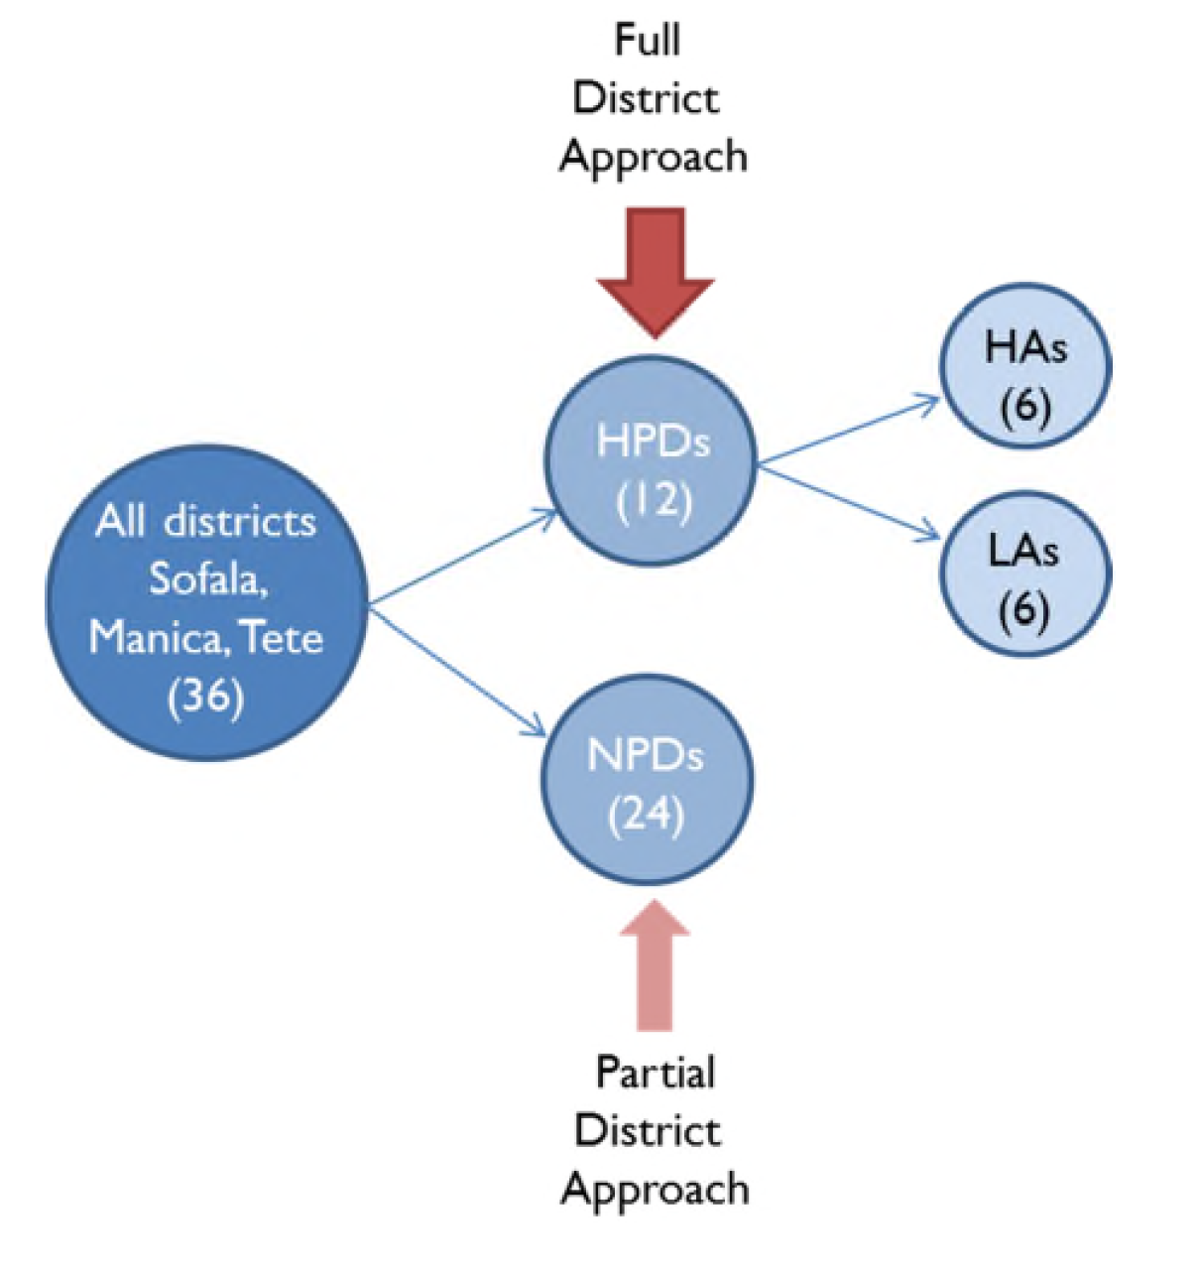
Study Design
Notes:
This table summarizes the design of the study. First we compared service delivery outcomes between HPDs (who received the full District Approach intervention, including the Graduation Path) and NPDs (who received a leaner version of the District Approach, which did not include the Graduation Path). For our second research question, we compared service delivery outcomes between facilities from HA districts and facilities from the LA districts.

Slide 8
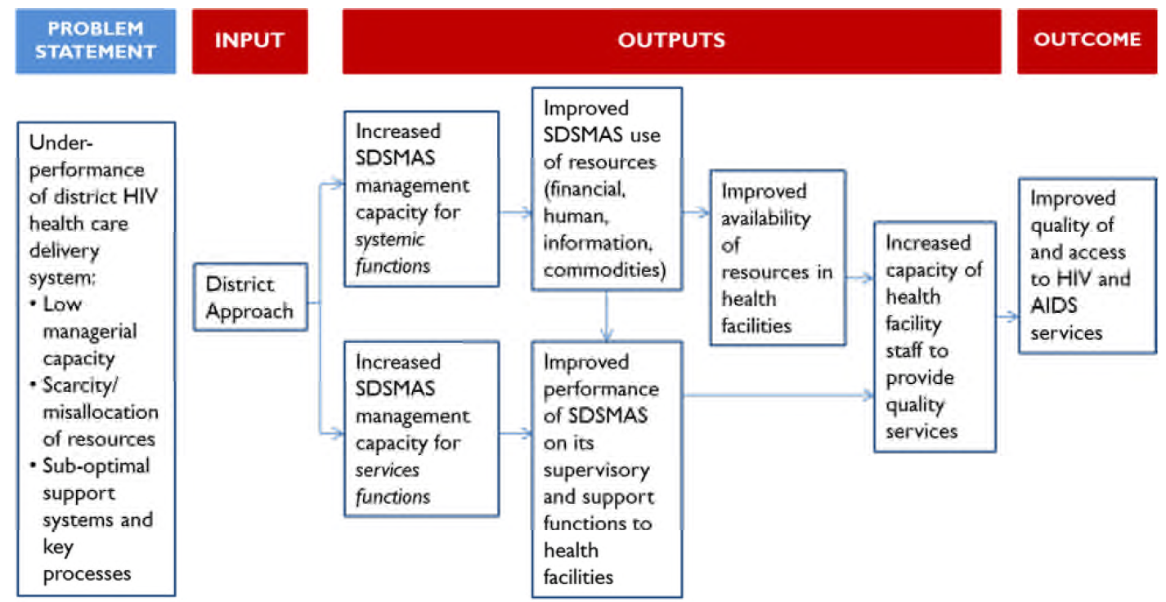
Theory of Change
Notes:
The District Approach includes interventions that are applied at the district, health facility, and community levels, aimed at addressing the key causes of underperformance. Because the focus of this study is on the effects of the strengthened district health system, our Theory of Change focuses only on the outputs that occur at the district level. This diagram displays the Problem Statement and illustrates the Theory of Change for how the District Approach (“Input”) first leads to strengthened district health systems in the form of improved management capacities (“Outputs”), which then lead to improved quality of and access to HIV and AIDS services (“Outcome”). District Approach interventions improve SDSMAS capacity to manage systemic functions and services functions. Each of these function categories follow their paths through sequential outputs towards the intended outcome:
Systemic functions path: increased capacity of SDSMAS to manage these functions (planning, information systems, human resources, financing, supply and logistics) enables districts to better plan for, acquire, use, and monitor resources such as funding, staff, information, and commodities. This in turn leads to (1) better availability of all these resources at the health facility, and also (2) supports SDSMAS’ ability to perform their supervisory and support functions to health facilities. Both of these outputs contribute to the increased capacity of facility staff to provide quality services, and finally the desired outcome of improved quality of and access to services.
Services functions path: increased capacity of SDSMAS to manage its health programs, laboratory services, and community engagement activities leads to better supervision and technical support to health facilities. This directly supports improved capacity of health staff to provide quality services, also leading to the desired outcome. The path from the services functions output to the outcome is shorter and more direct than the path from the systemic functions. However, the systemic functions reinforce the services functions.

Slide 9
Outcomes (access and quality)
1. # of new enrollees in ART
2. # of new enrollees in pre-ART care
3. # new pediatric patients in ART
4. % of pregnant women who know their HIV status
5. % of HIV+ pregnant women in ANC who receive ARVs
6. % of TB/HIV+ patients that initiate ART in TB sector
Notes:
In this study, we focused on six outcome variables: the first three variables relate to access to services, while the last three relate to service quality. These outcome variables were selected as they represent CHASS-SMT’s primary outcome indicators related to HIV prevention (i.e. eMTCT), care (i.e. new pre-ART enrollees), and treatment (i.e. new ART enrollees in HIV, Maternal and Child Health (MCH), and TB wards) service delivery. Furthermore, these outcome variables were deemed to be relatively sensitive to changes over time (unlike ART retention for instance) and data were easily accessible at all supported sites over the life of the project.

Slide 10
Methodology
“Difference-in-difference” multivariate analysis, comparing facilities from HPDs vs NPDs before and after the intervention
“Difference-in-difference” multivariate analysis, looking only at all HPD facilities before and after intervention, comparing “high achievement” (HA) districts vs “low achievement” (LA) districts
Control for multiple confounding factors
Supplemented with qualitative informant interviews
Notes:
We designed a mixed method study to achieve the study objectives described in Section 1.2. We used quantitative methods to investigate whether HPDs show better performance than NPDs, and most importantly, whether districts with greater improvements in their Graduation Path scores also show greater improvements in their service-delivery indicators (primary objectives). Using qualitative methods, we explored the mechanisms through which strengthened district health systems may affect HIV-service
provision (secondary objective). This section describes the methodology applied in each method, including the research questions that each component sought to answer.

Slide 11
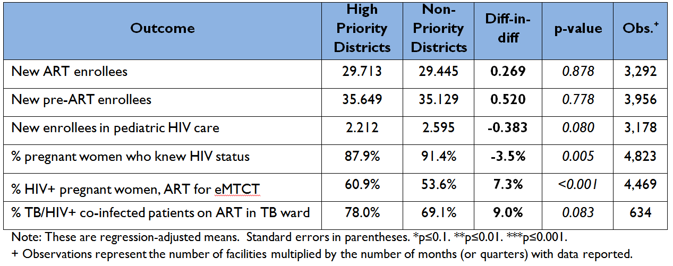
Quantitative Findings – HPD vs NPDs
Relationship Between Graduation Path Assessment Scores and Key Outcomes
Notes:
The analyses showed that the District Approach is associated with better performance on two of the three quality indicators, and with lower performance on the third quality indicator and on one access indicator.

Slide 12
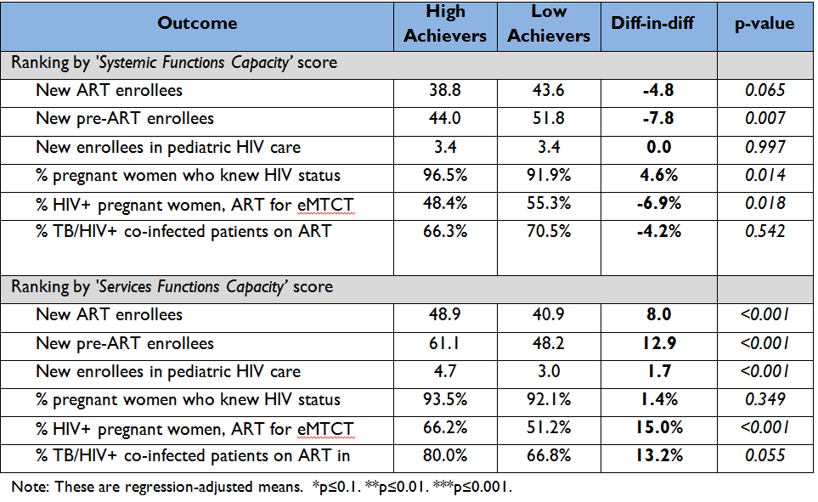
Quantitative Findings
Relationship Between Graduation Path Assessment Scores and Key Outcomes
Notes:
This table summarizes the results for the research question of whether there is a relationship between strengthened district management capacity and service delivery outcomes. Again, the second and third columns display the regression-adjusted means for the facilities from districts labeled HA and LA, respectively after the start of the intervention, taking all control variables at their estimated mean values, including the averages of the outcomes before the intervention. The fourth column represents the difference-in-difference estimate, which is the actual estimate of the relationship between the key outcomes and improvement in the district management capacity, measured by the scores from the Graduation Path assessments.
After ranking and labeling districts based on their scores for services functions management capacity, there was a positive, strong and statistically significant association between these scores and almost all of the service delivery outcomes, with the exception of the proportion of pregnant women who knew their HIV status after first consultation. As can be observed in the bottom panel of Table 8, in most cases, the magnitude of the coefficients is quite large: HA districts registered an average increase of 8 and 13 new ART and pre-ART enrollees, respectively, which represents increments of more than 20 percent. Similarly, for two quality outcome indicators (% of HIV+ pregnant women in ART, and % HIV+/TB patients on ART), the HA registered an increase of 15 and 13.2 percentage points, which is a very important improvement for facilities with high levels of unmet need for ART.
The team obtained mixed results when ranking districts by their scores on systemic functions management capacity. Four coefficients were statistically significant, however, three of the coefficients are negative and only one is positive.
These findings show that among the facilities that belong to the districts that received the full District Approach intervention (HPDs), the districts that experienced greatest improvement in services functions management capacity, as measured by their respective Graduation Path assessment scores, also experienced the greatest improvements in service delivery outcomes.
--------------
Results: The analyses showed that the District Approach is associated with better performance on two of the three quality indicators, and with lower performance on the third quality indicator and on one access indicator. Further analyses detected positive, statistically significant relationships between improvements in district capacity to manage services functions and improvements in five of the six service delivery outcome indicators. Results for systemic functions were mixed: there were negative associations with two access indicators and with one quality indicator, and a positive association with one quality indicator.

Slide 13
Qualitative Findings
Perceptions of improved district management capacity:
  Systemic functions:
    Sub-agreement most cited as perceived to have had an impact
    Improved information and data use
    Limited mention of direct linkages between improved management capacity and service delivery outcomes
  Services functions:
    Sub-agreement most cited as perceived to have had an impact
    Key informants able to link improved management capacity to improved service delivery outputs and outcomes
Notes:
4.2.1 Systemic functions
The most frequently-cited input perceived to have had an effect on management of systemic functions were district sub-agreements (Table 9). This included both the funding provided by the sub-agreements, which allowed for the implementation of routine activities, as well as the sub-agreement reporting requirements, which contributed towards improved information and reporting. Other inputs mentioned included the Graduation Path, the District Profile Analysis, and technical assistance. Informants were able to cite several specific improvements in district management capacity linked to those inputs, many of them related to improved reporting, documentation, and use of data. In most cases respondents also identified subsequent outputs from improved management capacity. However, in virtually none of those cases were they able to make the direct connection to improved service delivery (Outcome). This is consistent with the quantitative results, which suggests that systemic functions have a longer path towards the desired outcome and therefore would take a longer time to show a direct effect.
It is worth noting that respondents mentioned staff motivation as a subsequent output both under the Human Resources function, and also under Supply and Logistics. There was a distinct perception that training and improvement in the Human Resources system has led to increased staff motivation, which in turn is associated with better job performance.
4.2.2 Services functions
As with systemic functions, the inputs most frequently cited for services functions were also related to sub-agreements (Table 10). The sub-agreements and other direct material support enabled districts to acquire essential materials and carry out essential activities, such as training, distribution of medications and supervision to health facilities. Other interventions noted by respondents included the Graduation Path, targeted interventions, and clinical tutoring. In contrast with the systemic functions, it was much easier for respondents to link the output of improved management capacity of services functions to further outputs and even outcomes that are directly related to improved access to and quality of health services (hence in this table the last column includes Outcomes as well as Outputs).
Although staff motivation was not mentioned specifically as part of the causal pathway, in general most respondents also expressed the effect of improved working conditions with new material and equipment, and of capacity building on staff motivation and therefore performance.

Slide 14
Conclusions
District approach shows positive association with quality indicators
Within HPDs, increased district management capacity of systemic functions shows strong positive association with five of six service delivery outcomes
Qualitative results consistent with quantitative findings and theory of change
Results encouraging, consistent with recent studies and reviews on HSS-SD link
Notes:
Explain why we think we got mixed results with know HIV status quality indicator (high baseline) and with access indicators (expansion of ART to non-sample facilities which may have artificially decreased indicators in some districts)
According to theory of change and evidence we expect systemic functions to take more time to show associations.
Discuss main limitations of study – non-random assignment, confounders, short time lapse
Need more rigorous evaluations

Slide 15


Acknowledgements
Authors: Denise Jacobson, Jorge Ugaz, Daniel Lee, Carmeliza Soares da Costa Rosario, and Marcelo Castrillo
For a copy of the full study report: Daniel_Lee@abtassoc.com

