Slide 1
Lessons Learned from Health Financing Reform in Liberia
Better Health Systems: Strategies that Work
Presentation Series at the Global Health Council
Tesfaye D. Ashagari and Catherine Connor
February 7, 2012

Slide 2
Agenda
Liberia 2003-2009
Health Systems 20/20 strategy to improve health financing
Liberia’s new health financing policy

Slide 3
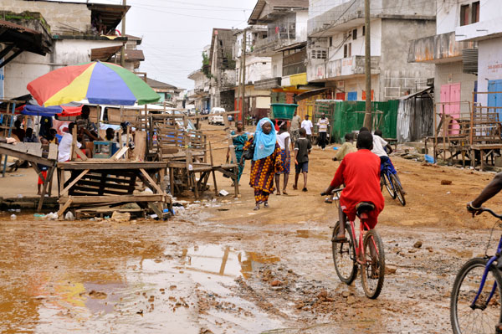
Liberia 2003
Destroyed infrastructure: facilities, roads, electricity, sanitation
Ex-combatants, displaced families, and torn communities
50% population in extreme poverty
Low literacy
Foreign debt = 1000x GDP

Slide 4
Liberian Health System 2003 - 2009
Common to many countries
Large but imbalanced distribution of service delivery network
Shortage of key health workers with right skills, motivation, remuneration
Clear overall policy directions yet to be internalized below the central level
Unique to post-conflict
Common problems are amplified with less capacity to fix
Destroyed clinics, labs, warehouses
Mental health, malnutrition
Humanitarian relief, dominance of foreign service providers

Slide 5
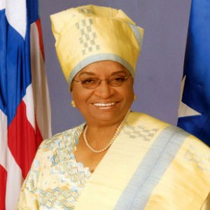
Signs of Strong Stewardship
2005 elections
President and MoF vision to move Liberia from recovery to sustainable development
Middle-income by 2030
$5 billion debt cancelled by IMF and bilaterals in 2010
Ellen Sirleaf Johnson
Elected President of Liberia, 2005 and 2011

Slide 6
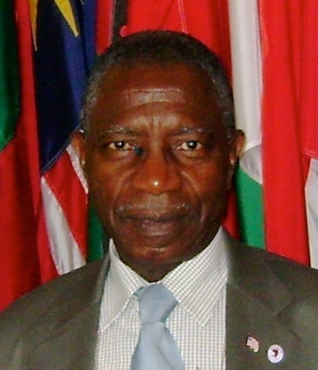
Signs of Strong Stewardship in Health Sector
2006-2011 health sector plan
Basic package of essential services
“Free care for all” policy
Pooled donor fund for health
Financial management office to manage other govt and donor funds
Performance-based contracts for private and public service providers
Walter T. Gwenigale, M.D.,
Minister for Health & Social Welfare

Slide 7
Key Health Financing Challenges in 2009
Clear overall policy direction for sector, but implications for financing not clear
Gaps in evidence
Polarized views of free care policy
Global recession cuts government health budget in 2009
Small, over-burdened team at ministry

Slide 8
Health Systems 20/20 Strategy
Generate and consolidate evidence
Consult stakeholders
Synthesize evidence and consultations for policy direction
Backstop policy and plan development
Capacity Building across all activities
Legal Council’s Office
Division of Policy and Health Financing
Notes:
Evidence generation
National health account (2007/08): overall per capita spending= US 29,
Source: donors contributed nearly half of the health spending, households 1/3rd, government 15%, corporations 3% --- raises issue of sustainability
Financing agents: MOH= 29%, JFK=4%, OOP=35%, NGOs=29%, Private companies & parastatals 4% (preliminary findings from the current institutional health spending (2009/10) indicate that although the amount of donor money of MOH manages has increased in absolute terms, the share of the health spending it manages has gone down).
Function: though there is no norm established as to the optimal mix curative care dominating the total health spending (53%) while spending on preventive care constituting 22% which is less than half that of on curative care indicating the imbalance in allocation.
Benefit Incidence Analysis: indicated the pro-rich bias in distribution of the public subsidies especially at the hospital level.
Burden of Household Spending: the share of out of pocket health spending out of the total household spending (among households that reported OOP spending) is higher for the poorest 20% (where the share is 16%) than the relatively better-off 20% (where the share is 7%).
Policy and Plan Status: would be good to mention that the financing policy has been submitted to the cabinet for final review and endorsement. Major provisions highlighted in the HF policy have also been incorporated as part of the overarching National Health and Social Welfare Policy and Plan- which has been endorsed and launched for implementation last jun by the president.

Slide 9
Health Systems 20/20 Strategy Implementation
NHA, BIA,
burden on
households +
PER, BPHS costing,
facility accreditation
Evidence generation/ consolidation
Stakeholder consultations
Synthesize evidence and consultation to draw out policy directions
Backstopping the policy and plan development
MOHSW submitted the new
Health Financing Policy to the
Cabinet in December 2011
Organized national
and county
consultations
Highly visual
presentation of key
findings and policy
options
Collaborated with World Bank
Notes:
Evidence generation
National health account (2007/08): overall per capita spending= US 29,
Source: donors contributed nearly half of the health spending, households 1/3rd, government 15%, corporations 3% --- raises issue of sustainability
Financing agents: MOH= 29%, JFK=4%, OOP=35%, NGOs=29%, Private companies & parastatals 4% (preliminary findings from the current institutional health spending (2009/10) indicate that although the amount of donor money of MOH manages has increased in absolute terms, the share of the health spending it manages has gone down).
Function: though there is no norm established as to the optimal mix curative care dominating the total health spending (53%) while spending on preventive care constituting 22% which is less than half that of on curative care indicating the imbalance in allocation.
Benefit Incidence Analysis: indicated the pro-rich bias in distribution of the public subsidies especially at the hospital level.
Burden of Household Spending: the share of out of pocket health spending out of the total household spending (among households that reported OOP spending) is higher for the poorest 20% (where the share is 16%) than the relatively better-off 20% (where the share is 7%).
Policy and Plan Status: would be good to mention that the financing policy has been submitted to the cabinet for final review and endorsement. Major provisions highlighted in the HF policy have also been incorporated as part of the overarching National Health and Social Welfare Policy and Plan- which has been endorsed and launched for implementation last jun by the president.

Slide 10
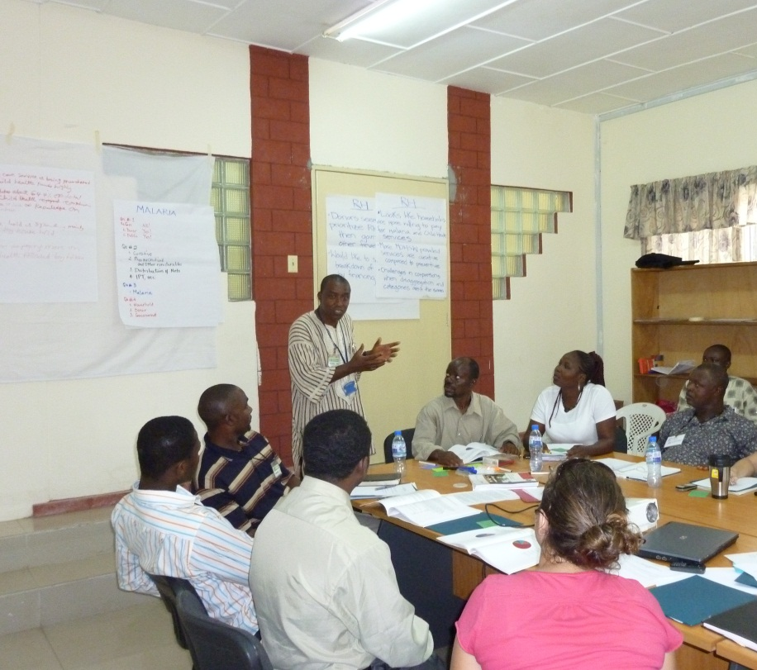
Health Systems 20/20 Strategy Implementation
Capacity Building to Sustain Implementation of the New Policy
Division of Policy and Health Financing
Day-to-day coaching by LTA
Health financing and presentation skills through rounds of presentation
Basic statistical analysis skills using SPSS
Legal Council’s Office
Update 1975 public health law
Develop consultative legislative approval process and timeline
Write new regulations – mental health, pharma, tobacco
Evidence generation/ consolidation
Stakeholder consultations
Synthesize evidence and consultation to draw out policy directions
Backstopping the policy and plan development
Notes:
Evidence generation
National health account (2007/08): overall per capita spending= US 29,
Source: donors contributed nearly half of the health spending, households 1/3rd, government 15%, corporations 3% --- raises issue of sustainability
Financing agents: MOH= 29%, JFK=4%, OOP=35%, NGOs=29%, Private companies & parastatals 4% (preliminary findings from the current institutional health spending (2009/10) indicate that although the amount of donor money of MOH manages has increased in absolute terms, the share of the health spending it manages has gone down).
Function: though there is no norm established as to the optimal mix curative care dominating the total health spending (53%) while spending on preventive care constituting 22% which is less than half that of on curative care indicating the imbalance in allocation.
Benefit Incidence Analysis: indicated the pro-rich bias in distribution of the public subsidies especially at the hospital level.
Burden of Household Spending: the share of out of pocket health spending out of the total household spending (among households that reported OOP spending) is higher for the poorest 20% (where the share is 16%) than the relatively better-off 20% (where the share is 7%).
Policy and Plan Status: would be good to mention that the financing policy has been submitted to the cabinet for final review and endorsement. Major provisions highlighted in the HF policy have also been incorporated as part of the overarching National Health and Social Welfare Policy and Plan- which has been endorsed and launched for implementation last jun by the president.

Slide 11
Draft HF Policy and Plan: Promoting Equity and Effectiveness
Equity
Essential package is free
Review user fee policies for secondary and tertiary care
Population-based resource allocation to ensure geographic equity
Effectiveness
Expand performance-based contracting to pay providers
Link payment to quality
Improve balance between hospitals and lower level facilities
Notes:
Efficiency and effectiveness
Pooling : including the major disease prevention and control programs, greatly facilitates resource allocation into single, comprehensive exercises.
Performance based contracting to incrementally replace block budget provider payment mechanism
Costing: straight forward

Slide 12
Draft HF Policy and Plan: Promoting Sustainability and Accountability
Sustainability
Cost the essential package
Link health budget to Medium-term Expenditure Framework
Predict donor support over medium-term horizon
Pool/track resources from all sources
Explore domestic revenue sources (sales and sin taxes; large employers)
Accountability
Institutionalize regular assessments like NHA
Add financing indicators into the HMIS
Notes:
Here please mention that for the presentation the major provisions have been summarized under 4 overarching objectives of the Health Financing Policy and plan is trying achieve.

Slide 13
Lessons Learned
Shift from short-term to long-term thinking
Be discrete and humble
Create a counter-weight to politicized debates/decisions
Fill the evidence gap
Consultation at all levels to give ‘voice’ to locals
Prepare for policy implementation
Intensive dissemination below central level
Detailed guidelines
Intensive capacity building
Notes:
Time for generating the necessary evidences may not be fully appreciated by senior management (given often times they come from medical background and the complication of health financing is not fully understood)

Slide 14
Thank you
”I prefer to be ‘in the kitchen’ and let the Ministry’s health financing team be in the spotlight”
Tesfaye Dereje
Health Economist Advisor in Liberia 2010-2011
Health Systems 20/20

